Slide 1
Foundation of computer science
By : Mohamed Agami

Slide 2

Lecture 8
Motherboard part 5

Slide 3
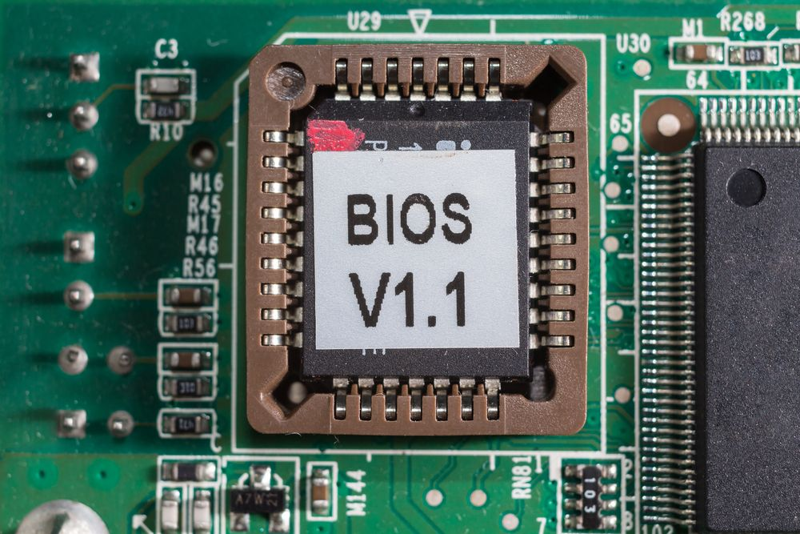
Firmware
It's a hardware chip you can see and touch, which involves software that runs code on a computer. combination of Hardware and software are firmware.

Slide 4

Firmware tasks
Enable or disable a connector, port, or component
CPU frequency control
Security features
What happens when you turn on your computer for the first time

Slide 5

Today's motherboards may use these types of firmware:
BIOS
Basic input / output service
UEFI
Unified Extensible Firmware Interface
UEFI With BIOS

Slide 6
BIOS

Slide 7
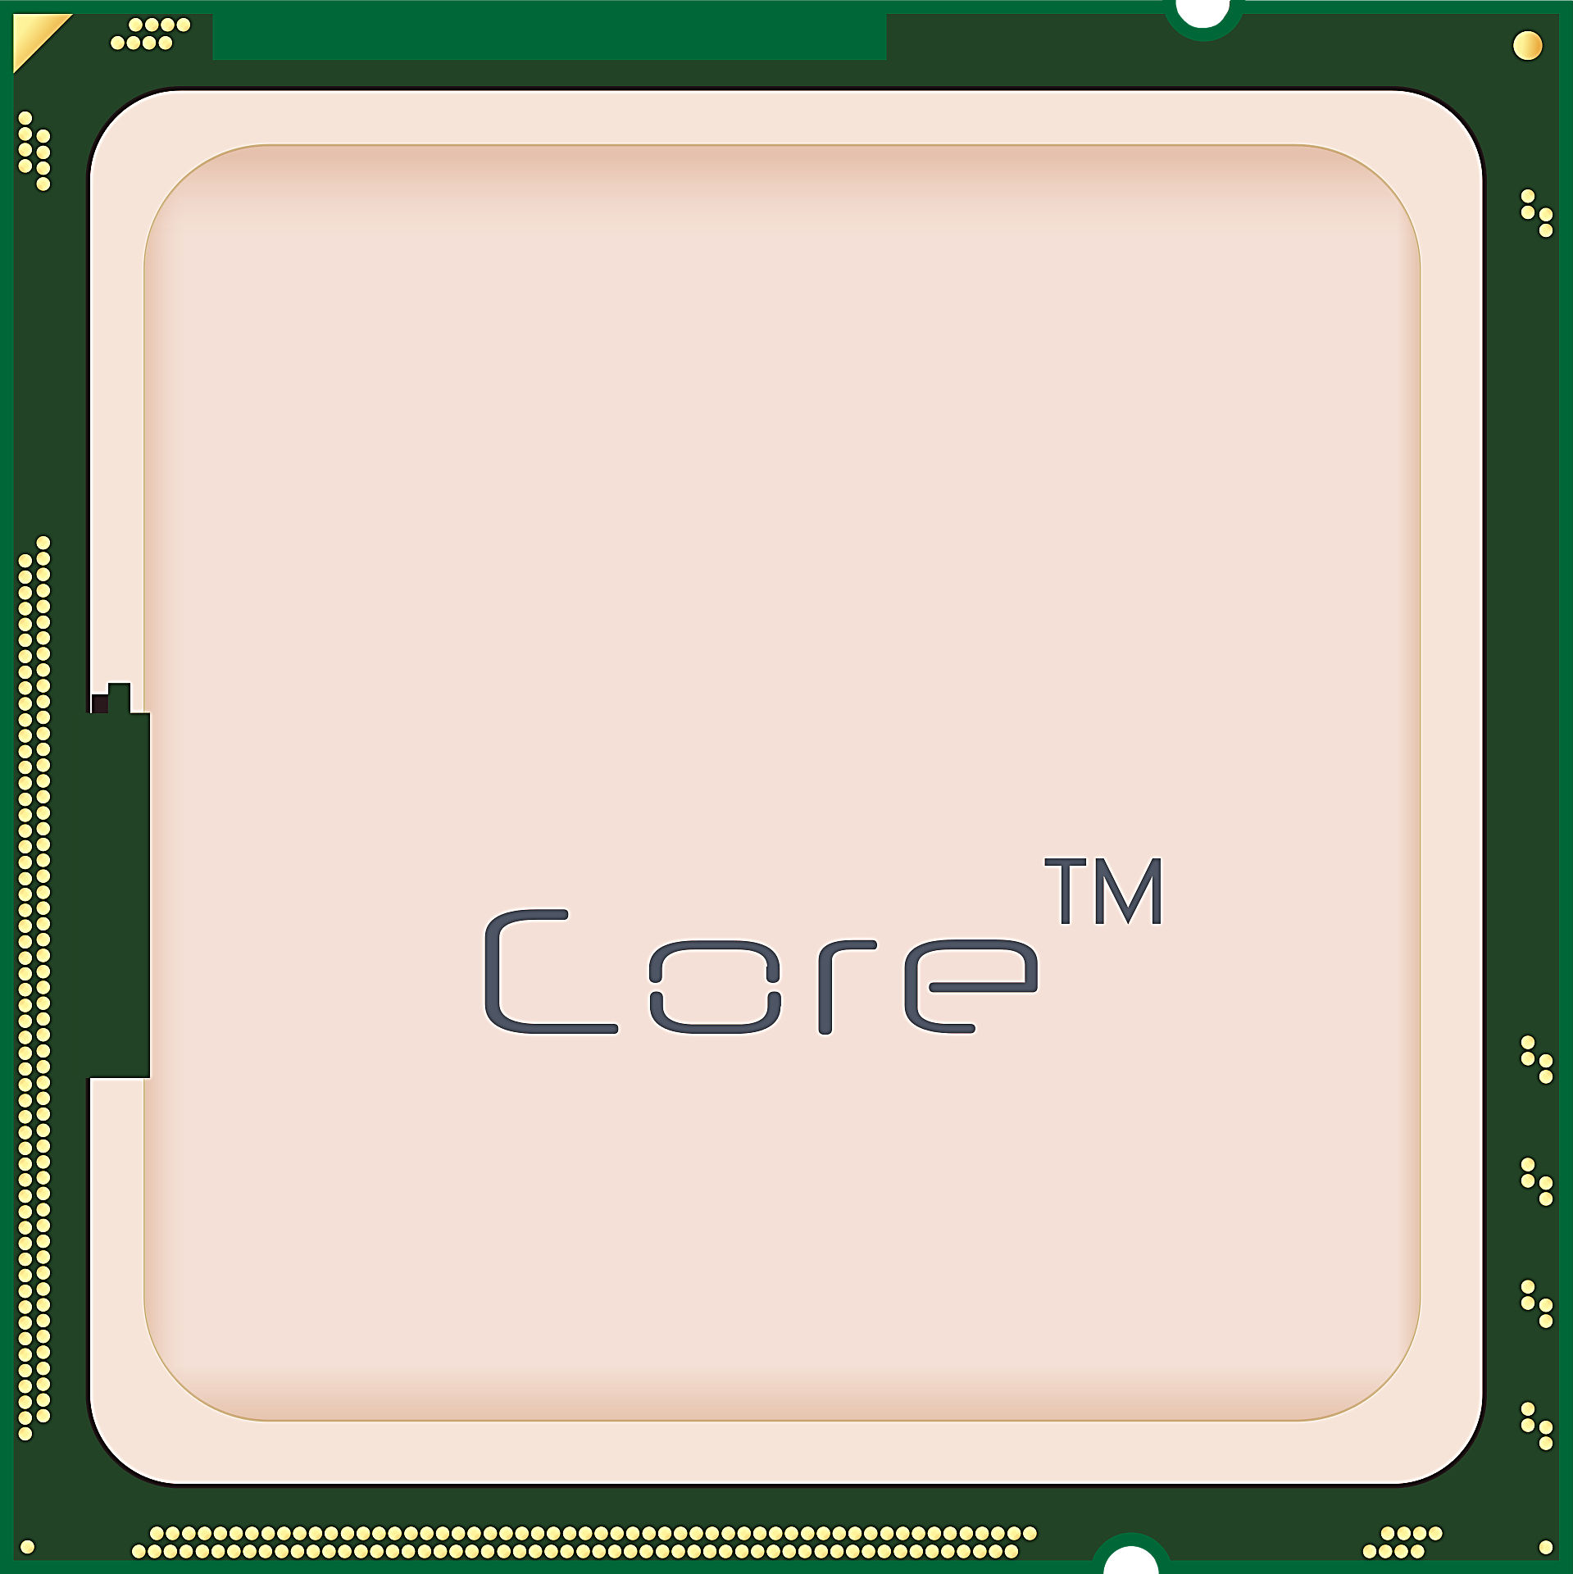
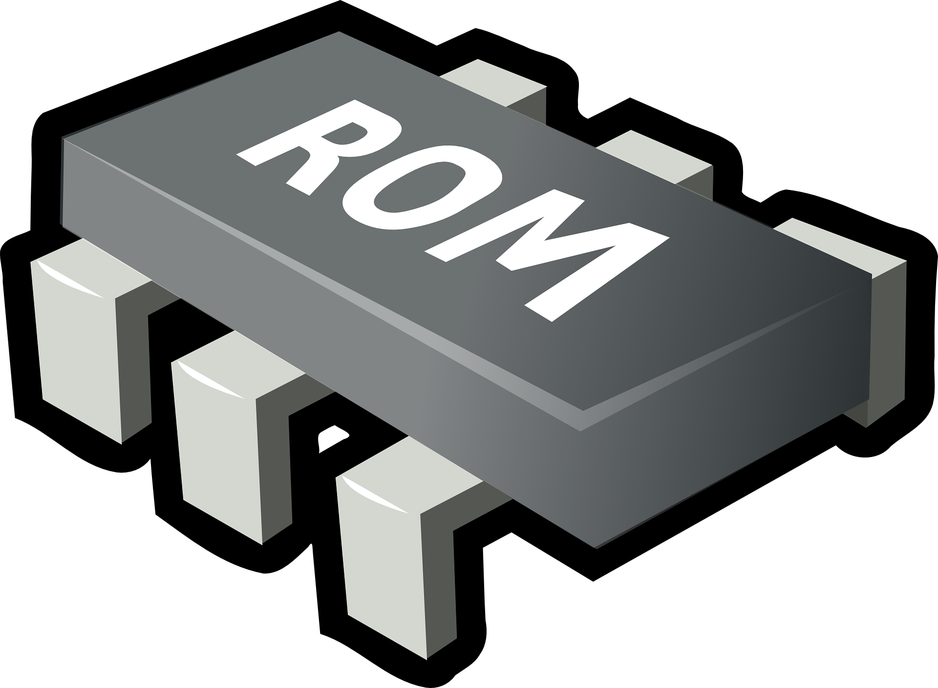
BIOS
ROM (Read only memory)

Slide 8

ROM (BIOS)
Devices connected to the motherboard fall into three categories:
Non-configurable devices Parameters
Configurable devices Parameters
Custom devices

Slide 9
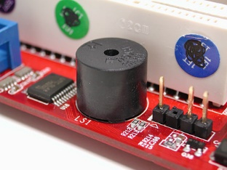
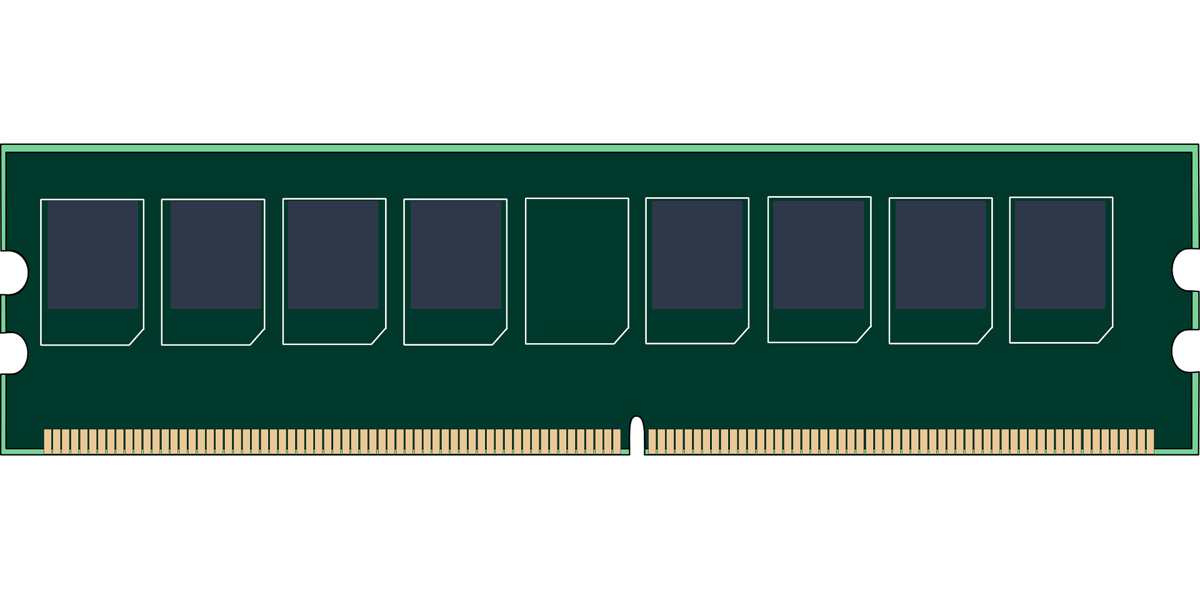
Non-configurable devices Parameters

Slide 10
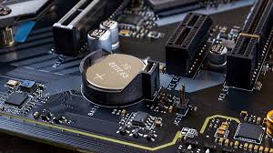

Configurable devices Parameters
CMOS Complementary Metal-oxide Semiconductor
CMOS

Slide 11
BIOS VS CMOS
BIOS | CMOS
ROM | RAM
Contains programs | Contains Parameters
Can’t be rewritten | Can be rewritten
Non-Volatile | Volatile

Slide 12
Custom devices
Built-in ROM
SCSI board
Video board
It may be present in some devices and others not
Device drivers
Sound board
Network adapters

Slide 13

PC boot process
Power -→CPU
CPU loads BIOS
POST operation
Power on-Self Test
Checks BIOS code
BIOS on video board checked and loaded
Checks for other BIOS programs
Device check(RAM-Keyboard,…etc.)
Search for boot drive

Slide 14
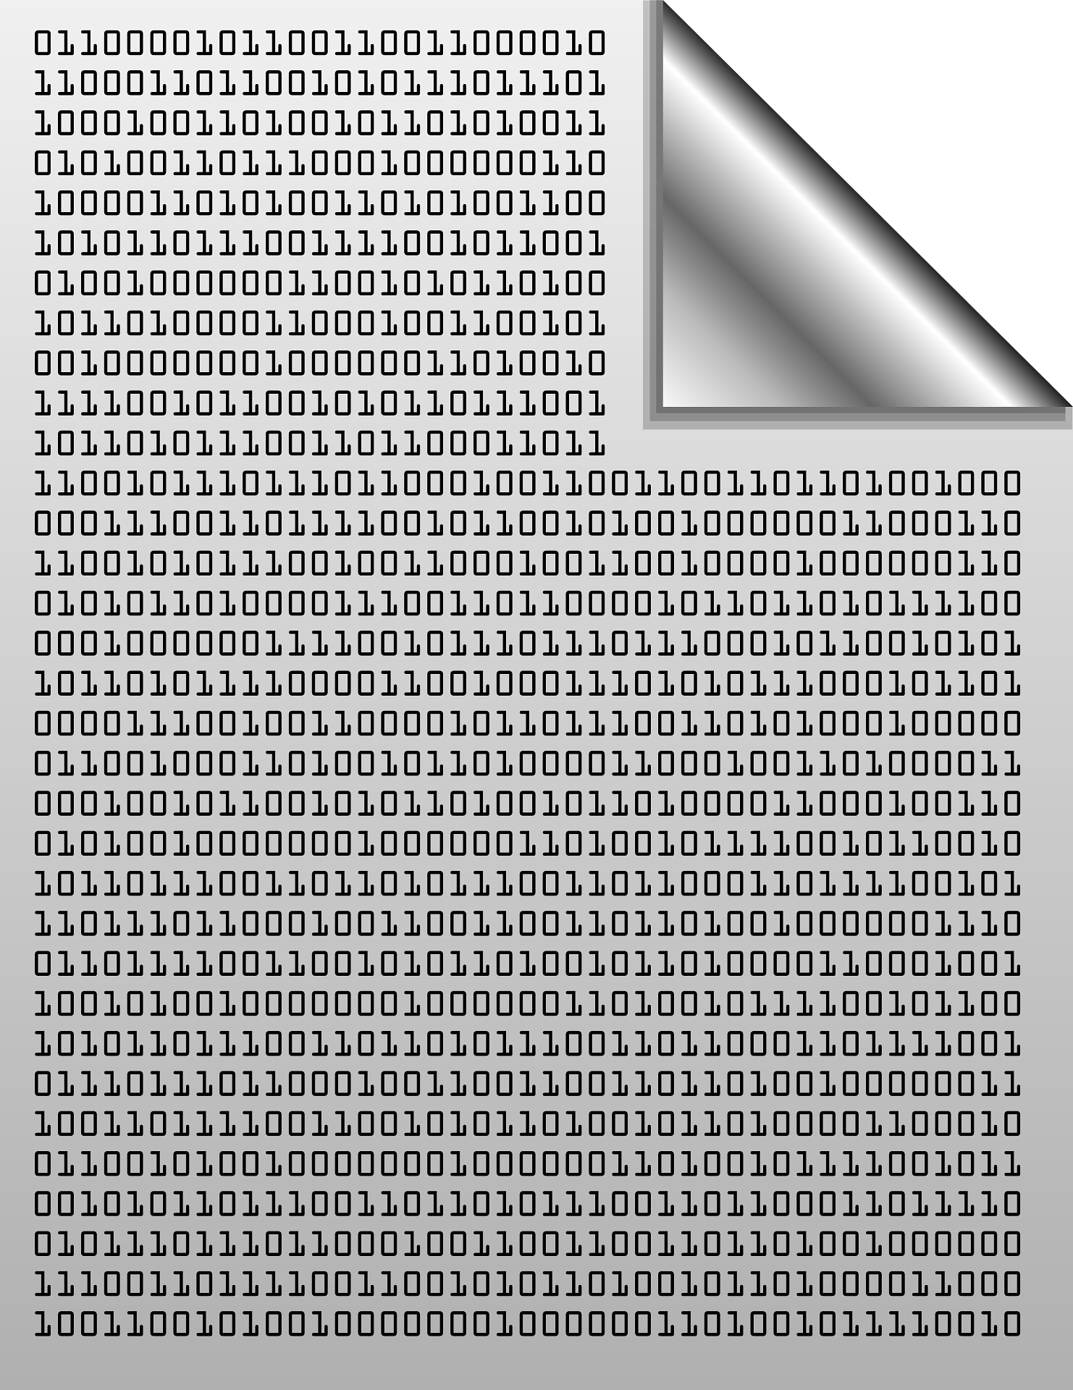



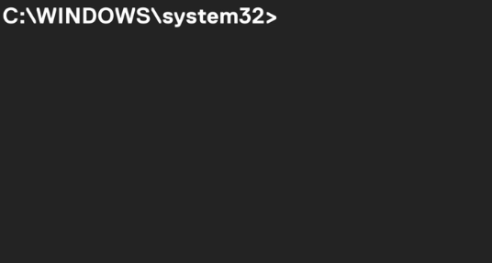
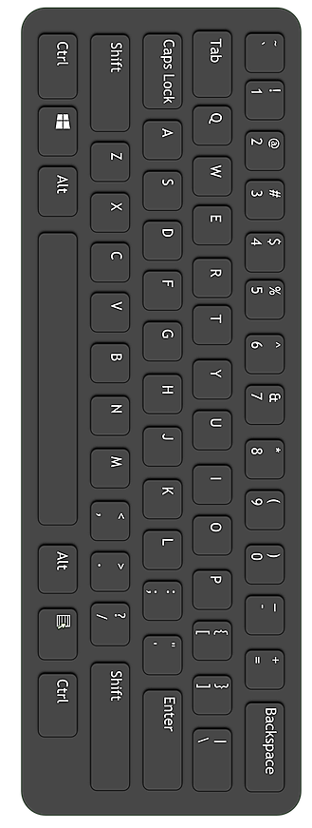
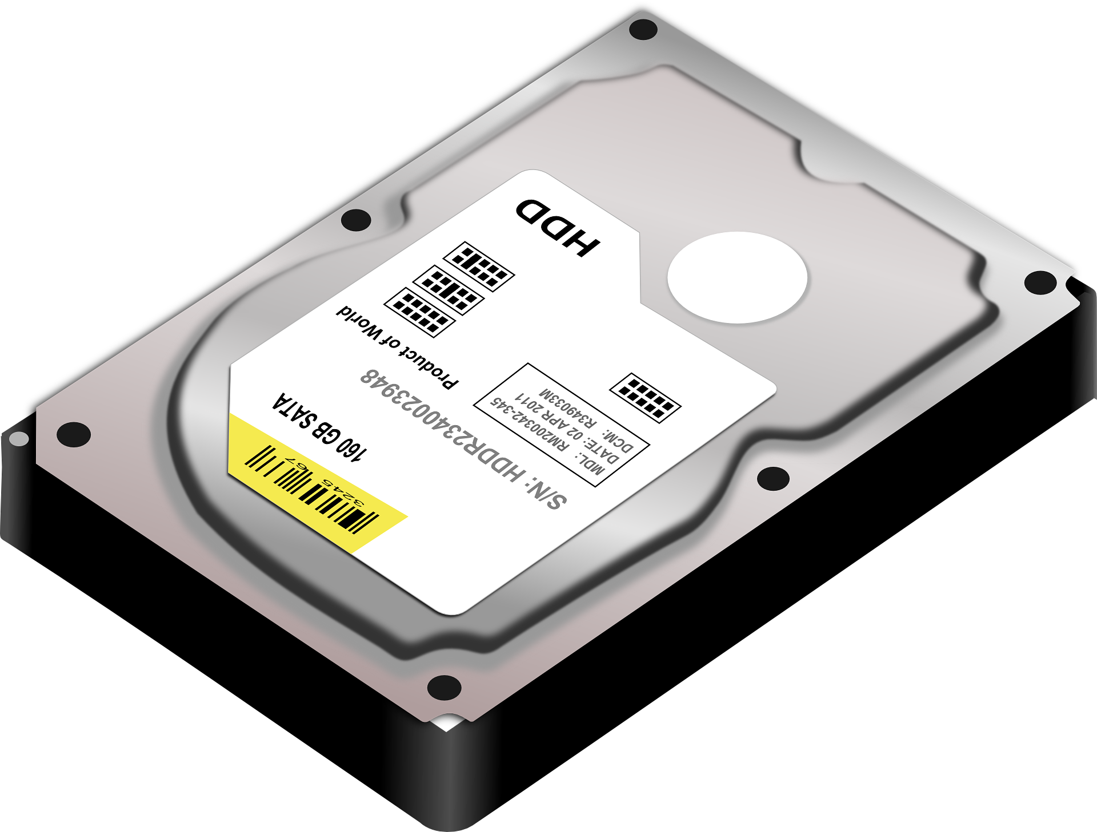

Slide 15
UEFI

Slide 16
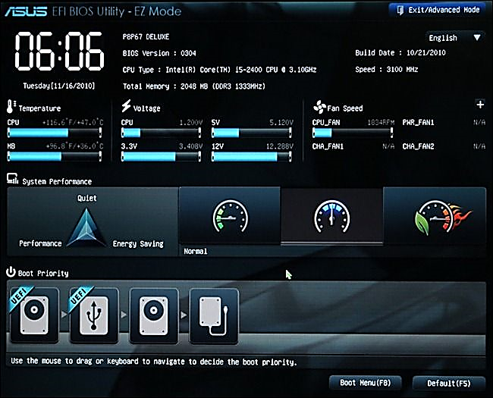
What is UEFI Interface
Unified Extensible Firmware Interface (UEFI) is a modern firmware standard that manages the boot process of a computer. It acts as an interface between the operating system and the platform firmware. UEFI is an advancement over the older BIOS system, offering several advantages:

Slide 17





Advantages Compared to BIOS
Faster Boot Times: UEFI supports more efficient booting compared to BIOS.
Larger Storage Support: UEFI can handle boot drives larger than 2TB.
Graphical Interface: Unlike BIOS, UEFI often includes a user-friendly graphical interface.
Secure Boot: It includes a security feature that helps prevent unauthorized or malicious code from loading during startup.
Advanced Features: UEFI supports features like network booting and more flexible management of hardware resources
In summary, is a more modern, flexible, and secure system UEFI compared to traditional BIOS.

Slide 18
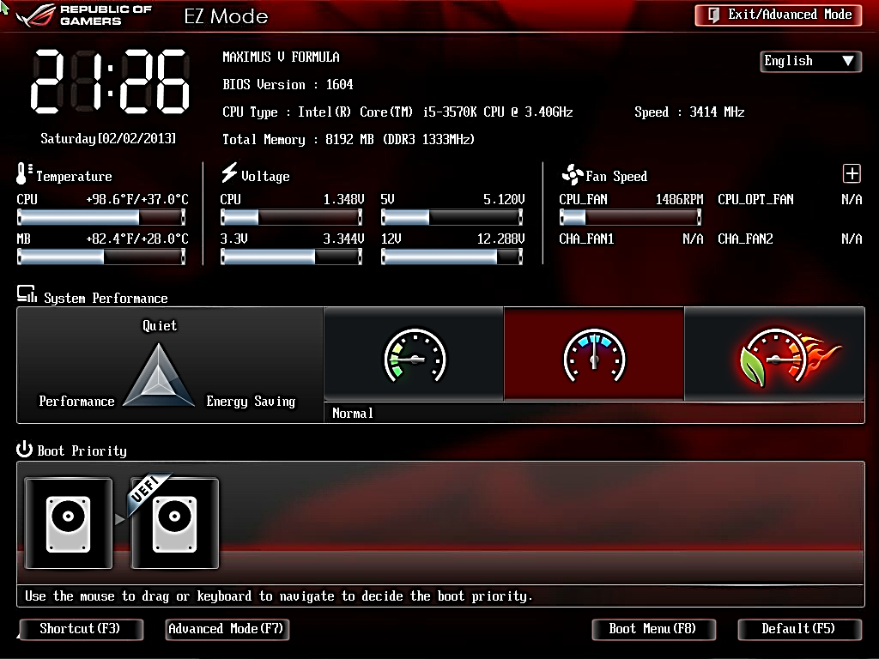
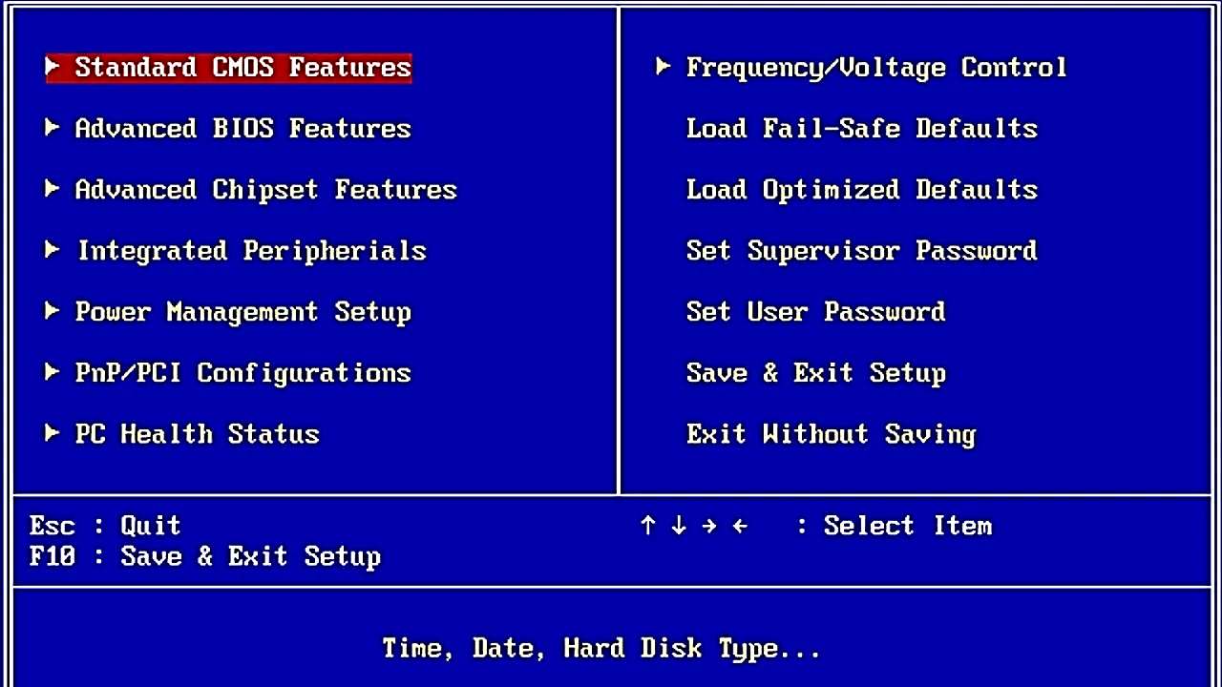

Slide 19
MBR VS GPT
MBR (Master Boot Record)
GPT (GUID Partition Table)
Up to 2 Terabytes (TB)
Up to 18 Exabytes (EB)
Up to 4 primary partitions
Up to 128 or more partitions
3 primary and 1 extended partition
without needing extended partitions
Does not support Secure
Supports Secure Boot
not specifically support SSD
Better performance with SSD

Slide 20
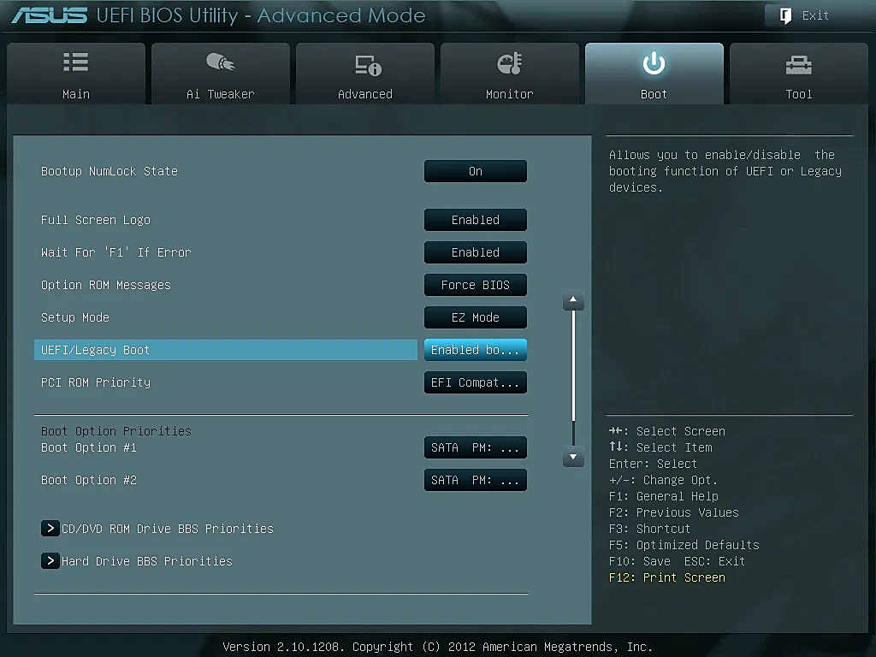
UEFI allows for backward compatibility. It can boot from a MBR hard drive and provides a BIOS boot through its Compatibility Support Module (CSM) feature.
CSM is backward compatible with devices and drivers that use BIOS

Slide 21
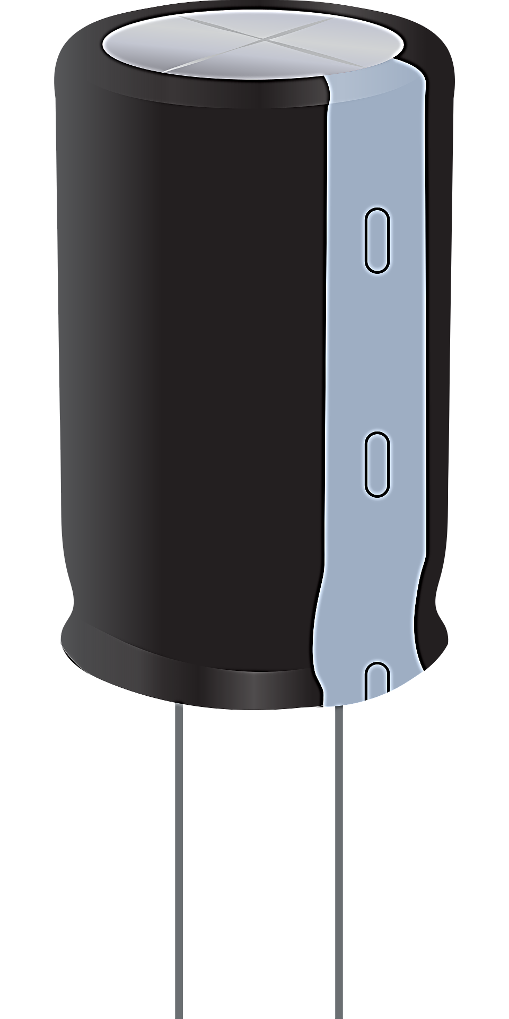
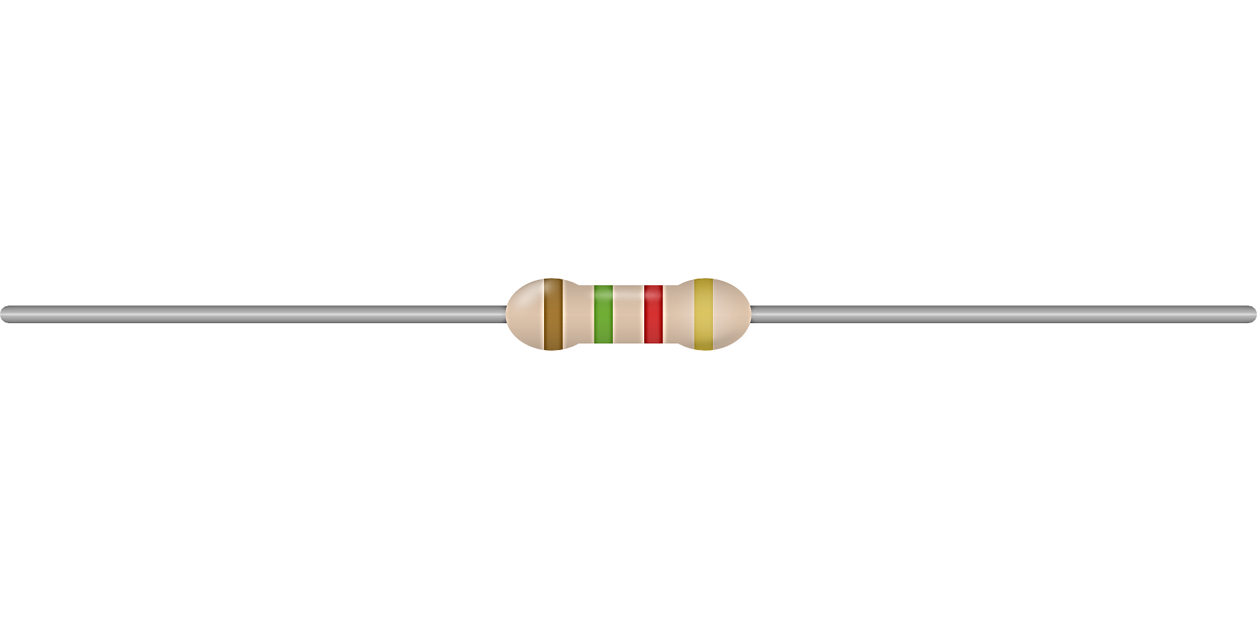
Maintaining a Motherboard
To maintain a motherboard, you need to know how to
Update the motherboard drivers
Flash BIOS or UEFI
Replace the CMOS battery

Slide 22
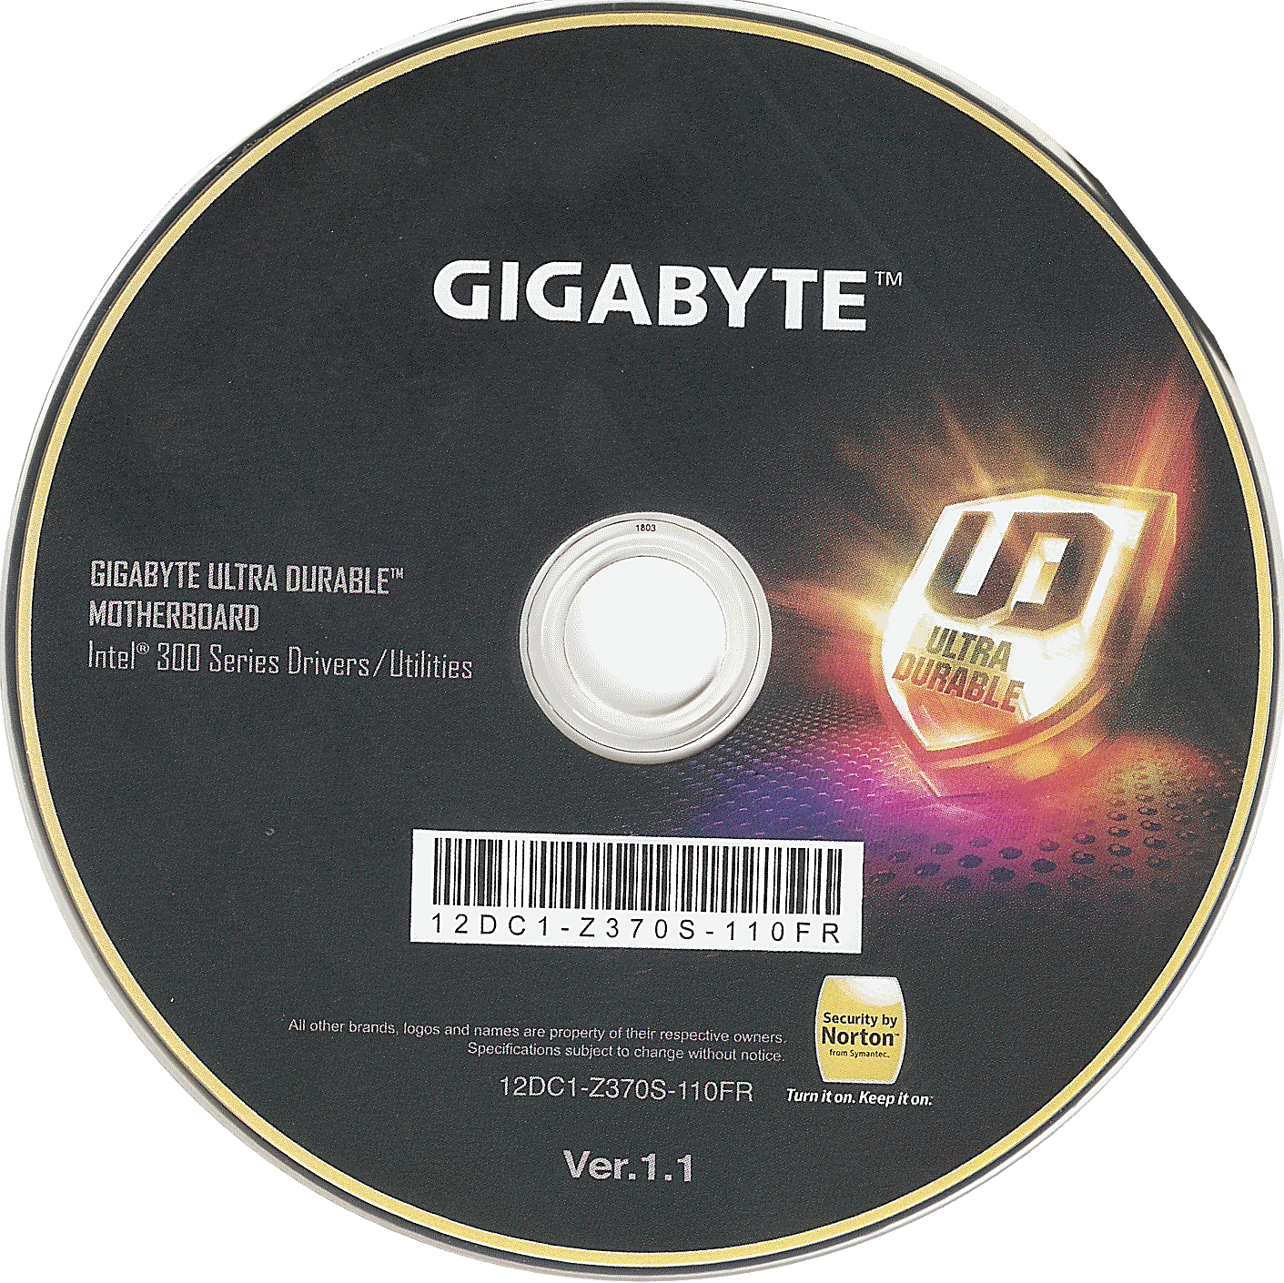
Update the motherboard drivers

Slide 23
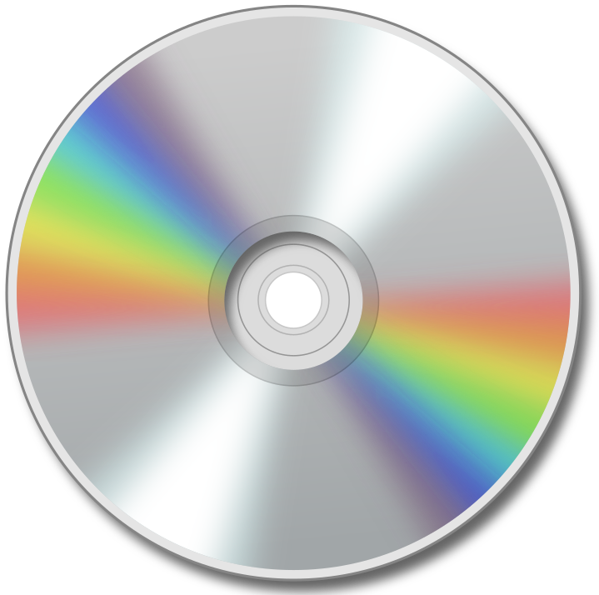
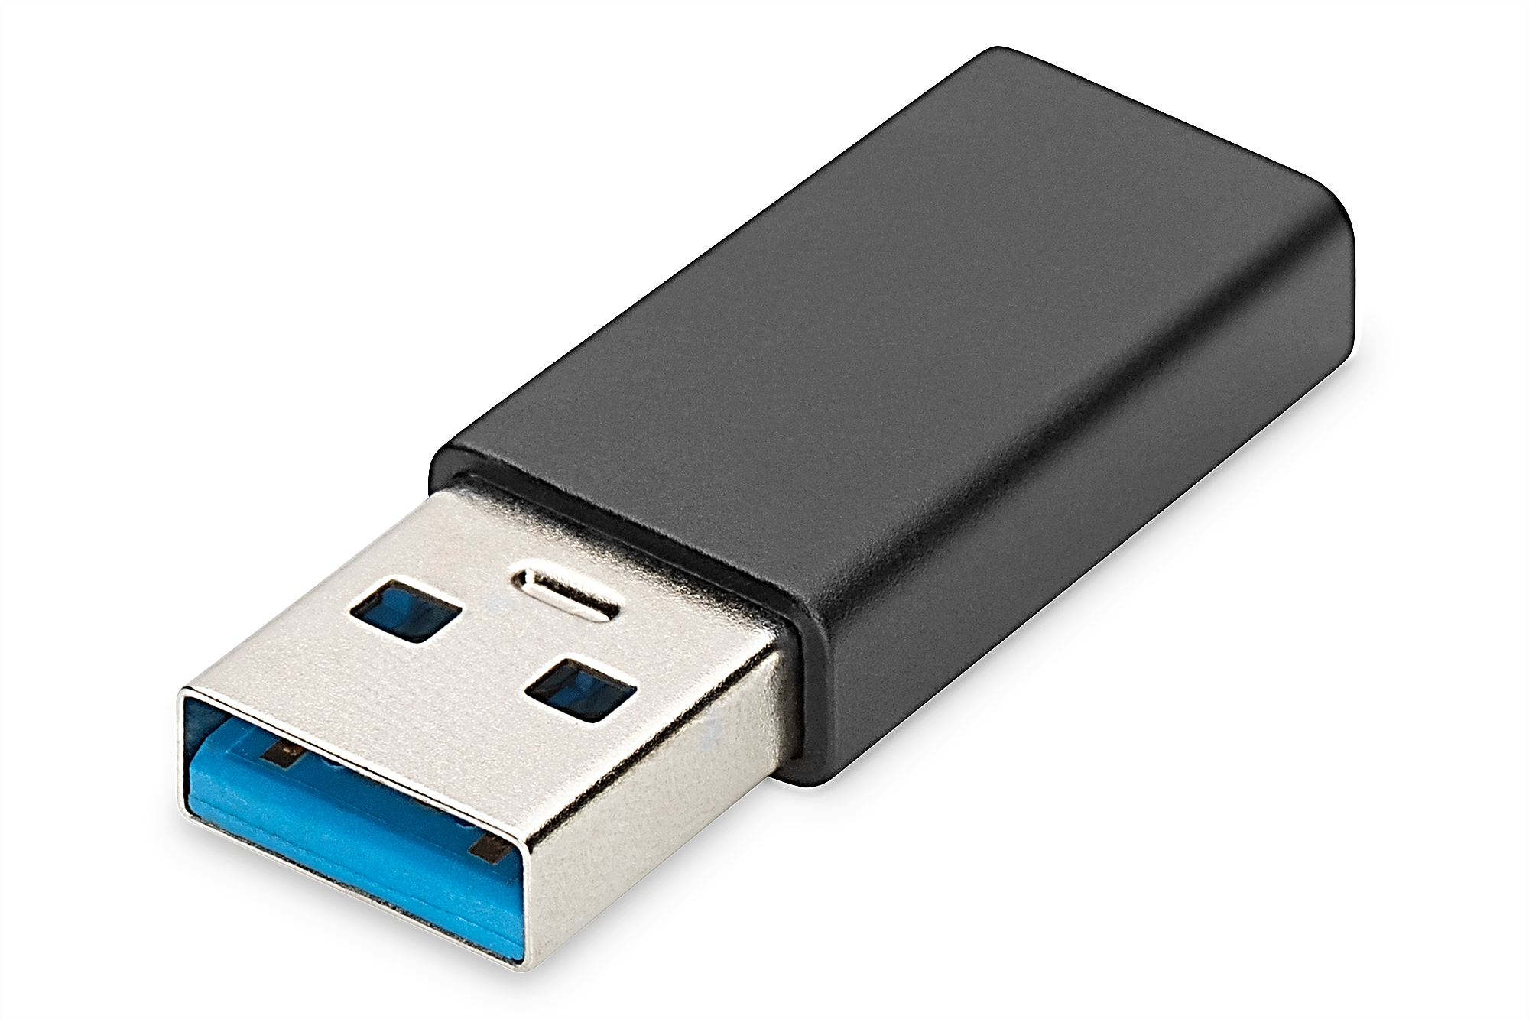
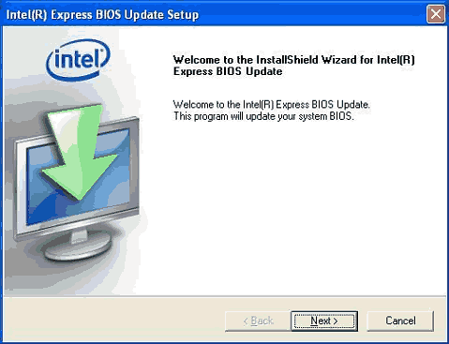
Flash BIOS or UEFI
Express BIOS update.
Update from a USB flash drive using BIOS setup.
Update using a bootable CD.

Slide 24
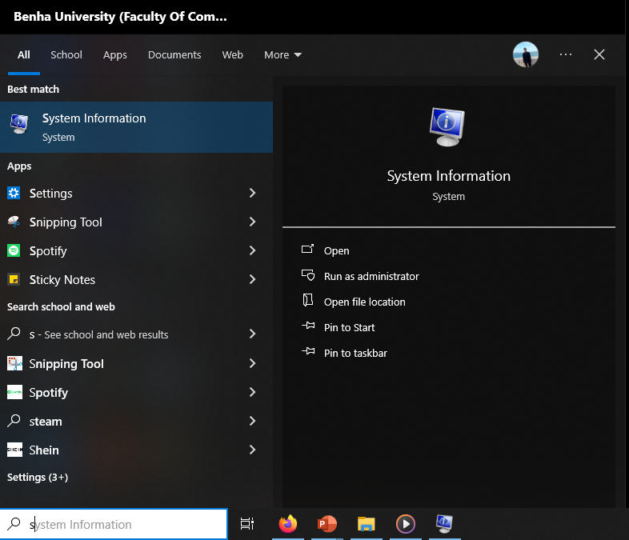
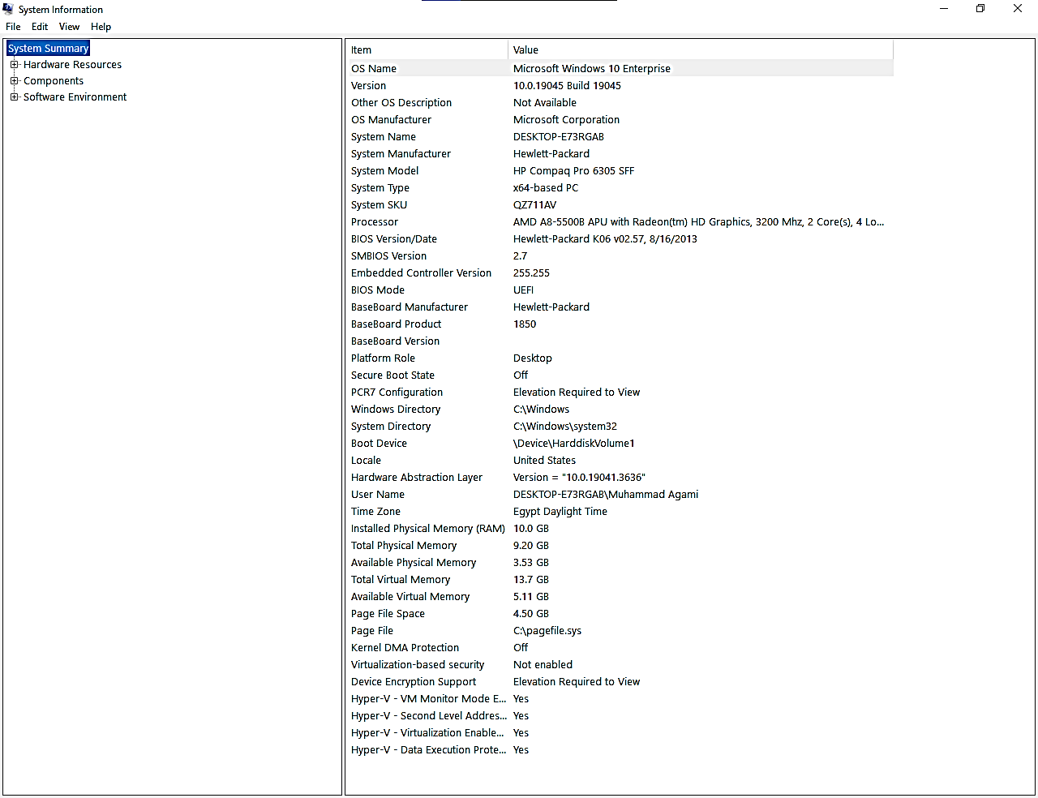

Slide 25
Using Jumpers To Clear Bios Settings
Jumpers
CMOS RAM
DIP switches

Slide 26
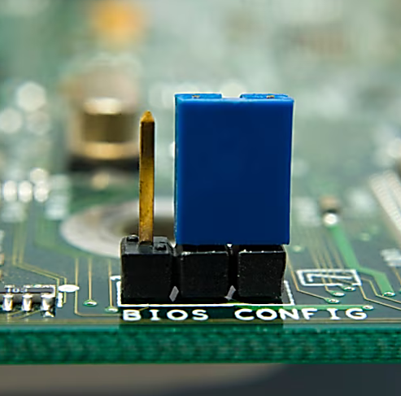
Jumpers
CMOS (Clear CMOS)

Slide 27
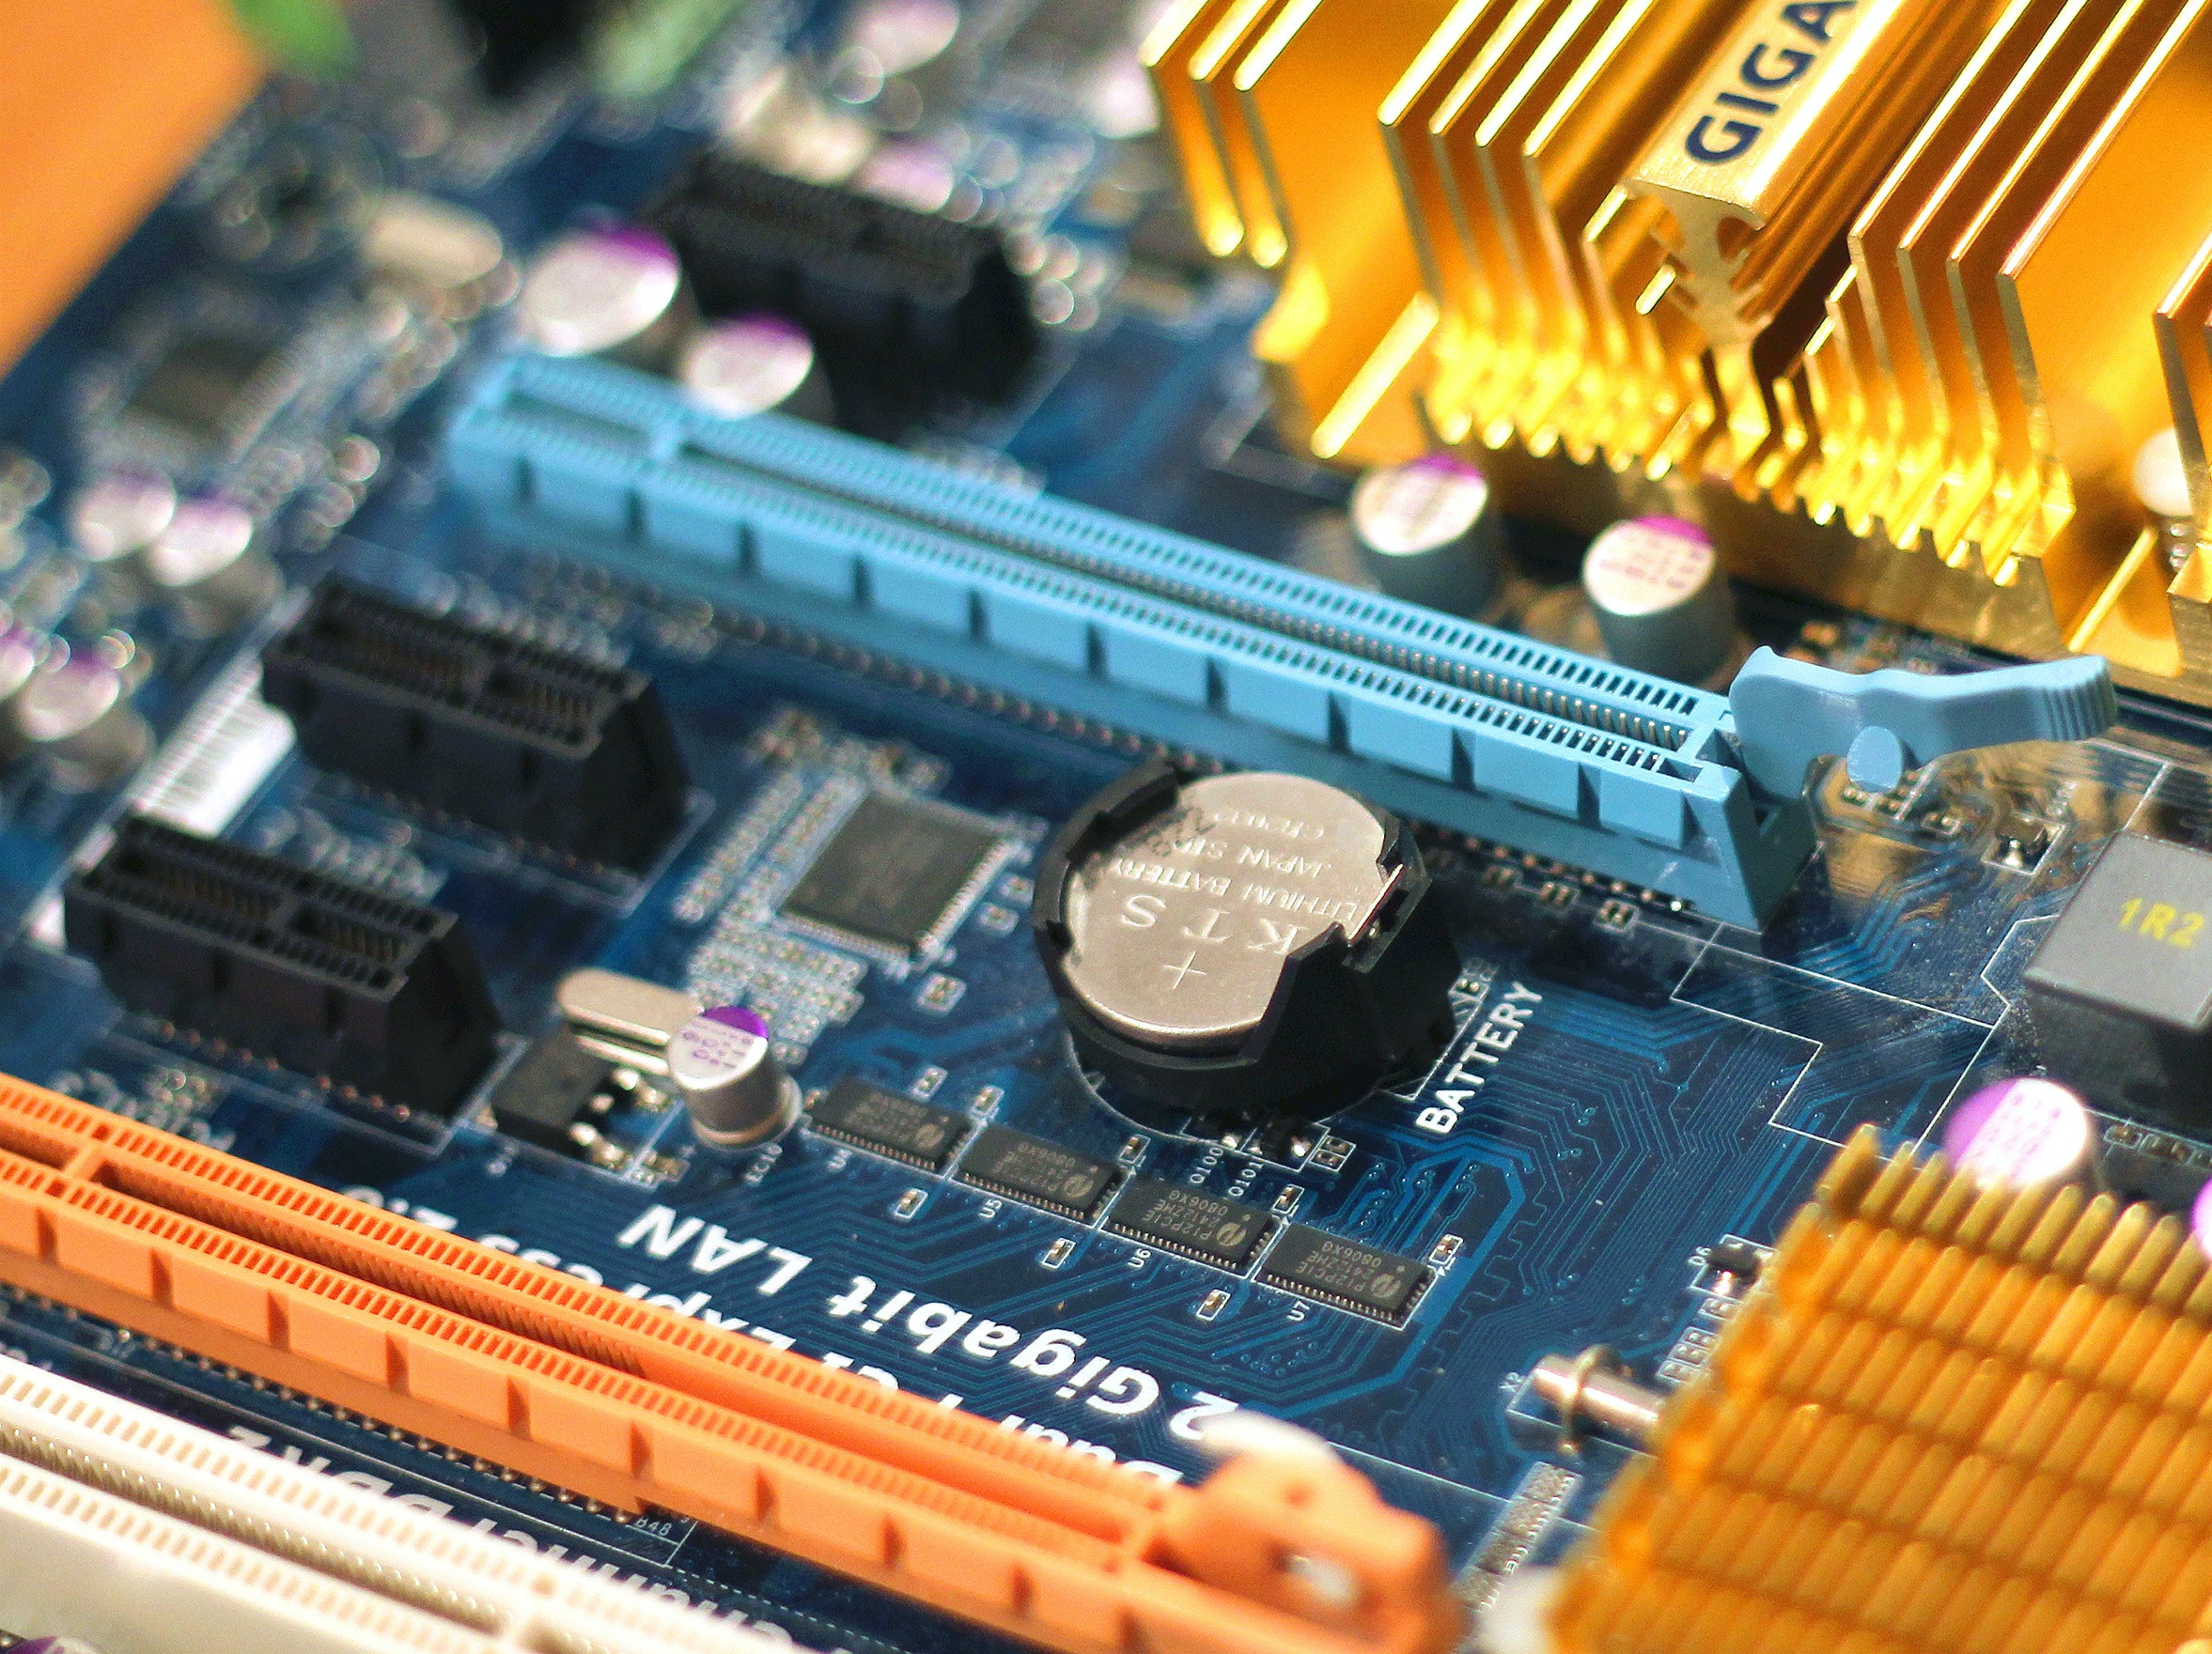
CMOS RAM

Slide 28
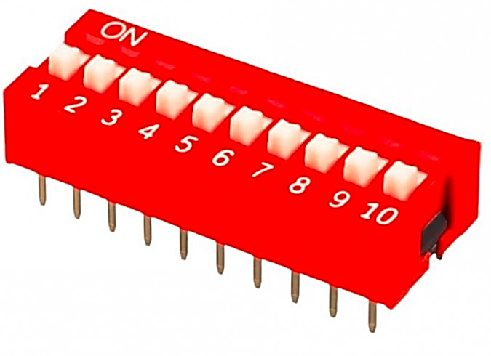
DIP switches

Slide 29

Tank you

